Slide 1
CP1402 – Internet Fundamentals
VLSM
Variable-Length Subnet Masks

Slide 2
Supernetting
Supernetting
Combine contiguous networks that all use the same CIDR block into one supernet
Also called classless routing or IP address segmentation
Supernetting is helpful for two reasons:
Reduce the number of routing table entries by combining several entries
Allow a company to create a single network made up of more than one Class C license

Slide 3
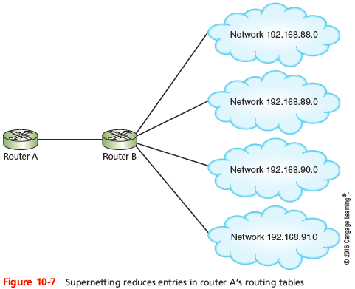
Supernetting
Supernet: 192.168.88.0/22
Notes:
Supernetting

Slide 4
Example
Let’s calculate the supernet for
209.224.18.0/24
209.224.21.0/24
209.224.22.0/24
Dissimilar Octet | Convert to binary | Determine common bits
18 | 00010010 | 00010 | 010
21 | 00010101 | 00010 | 101
22 | 00010110 | 00010 | 110
Supernet octet is: |  | 16
The first two octets are the same, so 16 bits initially in common.
5 bits in common: so mask is 16 + 5 = 21
Supernet: 209.224.16.0/21

Slide 5
POGIL 4 - Supernetting
What is the single summarised network address and mask for
201.10.177.0/24
201.10.181.0/24
201.10.184.0/24
201.10.188.0/24

